Slide 1
What Causes Changes in Air Pressure?

Slide 2
Ideal Gas Law
Although gravity is constant across the Earth, the amount of air above a point can change based on other atmospheric factors.
A change in the amount of air will lead to a change in pressure.
The relationship between pressure and other variables is described in an equation known as the Ideal Gas Law:
$$pV=mR_{d}T$$
p = pressure; V = volume; m = mass; T = temperature
R_{d} is a constant for dry air, so it doesn’t change

Slide 3
Ideal Gas Law
$$pV=mR_{d}T$$
Pressure (p) is a measure of the force of the air molecules when they impact the walls of a container.
Volume (V) is a measure of the space of a container.
Mass (m) describes how much air is in the container.
Temperature (T) describes how fast the air molecules are moving.
How do these variables relate?
More molecules means more impacts (higher mass = higher pressure)
More space means lower pressure (higher volume = lower pressure)
Faster molecules means stronger impacts (higher temperature = higher pressure)

Slide 4
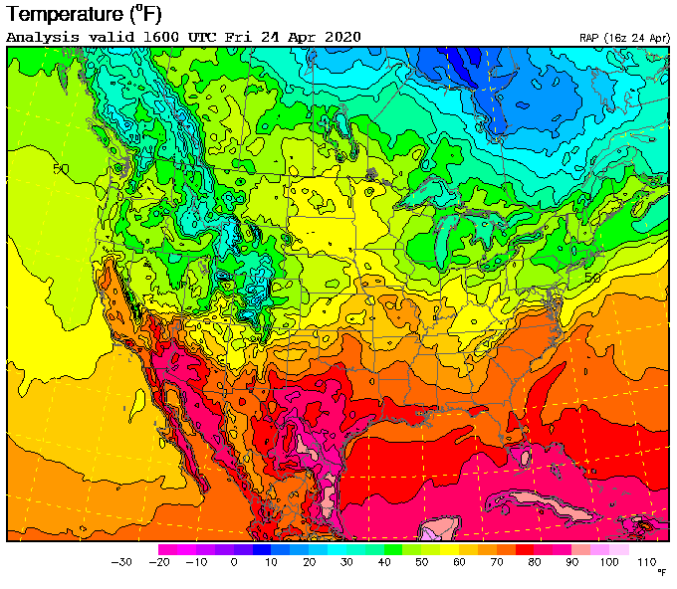
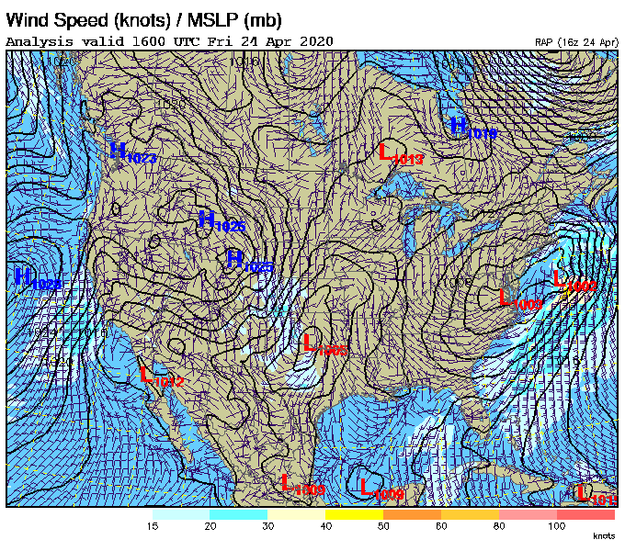
Temperature and Pressure
Air temperature changes substantially within the atmosphere, which means pressure must also change.

Slide 5
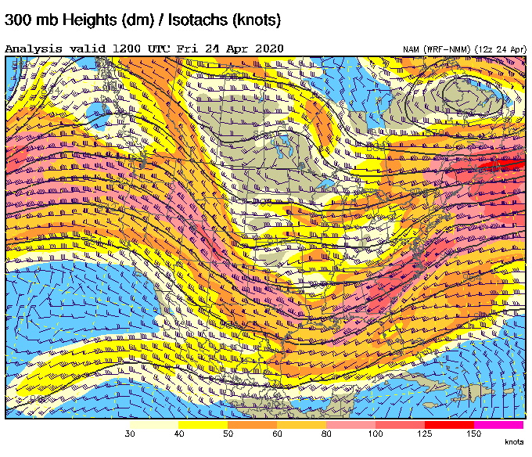
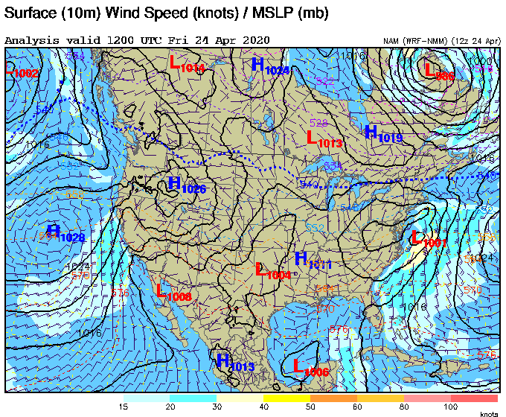
Density and Pressure
Since the mass of air remains constant throughout the atmosphere, meteorologists use density (mass / volume) to account for changes in volume.
Where mass “piles up” due to air converging into an area, pressure will increase (and vice versa). This is how large high- and low-pressure areas form.

